Slide 1
STOP THE hATE
MALTZ MUSEUM’S ESSAY WRITING CONTEST
LEARN.MALTZMUSEUM.ORG

Slide 2
Stop the hate Essay Contest BE THE LIGHT learn.maltzmuseum.org
Courtney Krieger, Manager of Family Programs & Outreach, Maltz Museum
ckrieger@mmjh.org

Slide 3
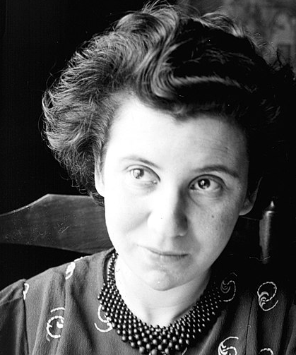
I no longer believe that we can change anything in the world until we have first changed ourselves. ~ Etty Hillesum Etty Hillesum was a young, Jewish-Dutch woman who wrote diaries in Amsterdam during World War II. In 1943, she was murdered at Auschwitz, at only 29 years old.
PERSONAL CHANGE:
What is a definition, word or a feeling that describes personal change?
Examples of personal change?
Notes:
Etty believed internal personal change was a necessary first step to bringing about positive change in the world, and that this was the main lesson to be learned from the Holocaust.

Slide 4
We want to know what you believe. You have a voice!
Essay Requirements:
500 words or less
True Story: Have you seen (even on TV), witnessed or experienced acts of racism, discrimination or hate based on race, gender, religion or other reasons?
No School Name, No First/Last Names
Take a stand. Speak up!
Action plan! Share your personal change! How can your own change lead others to also change in a positive way?
Learn.maltzmuseum.org
Due: ​
6th-10th
Thurs., February 8, 2024 ​
11th-12th
Thurs., February 15, 2024 ​
​

Slide 5
WE WANT TO KNOW WHAT YOU BELIEVE. YOU HAVE A VOICE!
AWARDS
9th-10th
1st place winner: $400 cash prize
2nd place winner: $100 cash prize
11th-12th
Grand Prize Winner: $20,000 scholarship + $5,000 grant for their school
First Runner Up: $10,000 scholarship + $2,000 grant for their school
Second Runner Up: $5,000 scholarship + $2,000 grant for their school.
(7) Honorable Mentions: $1,000 cash prize + $500 grant for their schools
All winners receive a free one-year membership to the Maltz Museum.

Slide 6
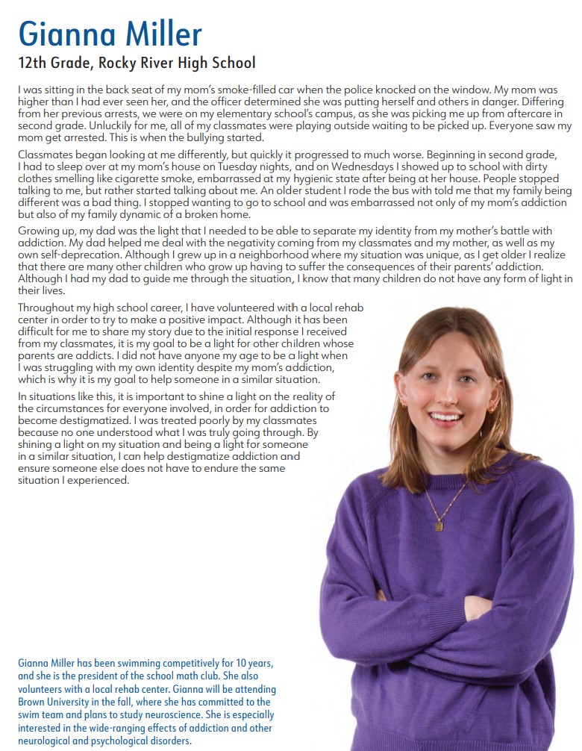
We want to know what you believe. You have a voice!
Gianna Miller
THINK ABOUT:
What was the problem? What was the injustice?
How do you think this injustice impacted others?
What kind of personal change did this experience inspire in Gianna?
How can her change lead to positive changes in others?

Slide 7
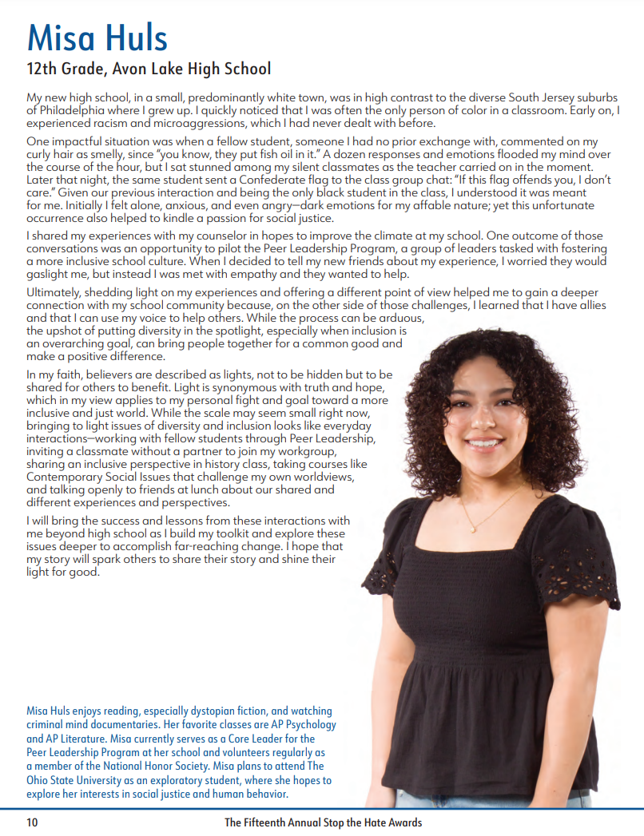
We want to know what you believe. You have a voice!
Misa Huls
THINK ABOUT:
What was the problem/injustice?
How do you think this injustice impacted others?
What kind of personal change did this experience inspire in Gianna?
How can her change lead to positive changes in others?

Slide 9
Stop the hate: Make that Personal Change! Make a difference! Be the difference learn.maltzmuseum.org
Courtney Krieger, Manager of Family Programs & Outreach, Maltz Museum
ckrieger@mmjh.org

